Slide 1



Generating Query-Specific Class API Summaries
Mingwei Liu¹, Xin Peng¹, Andrian Marcus², Zhenchang Xing³,
Wenkai Xie¹, Shuangshuang Xing¹, Yang Liu¹
¹Fudan University , China
²The University of Texas at Dallas , USA
³Australian National University , Australia
Notes:
Good morning, every one. I’m Mingwei Liu from Fudan University in China. Today, I will present our work: “Generating Query-specific Class API summaries”.

Slide 2
/01
Motivation
Notes:
不需要说

Slide 3


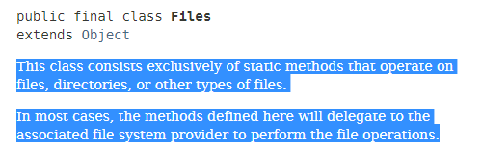

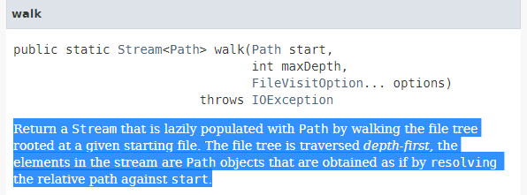
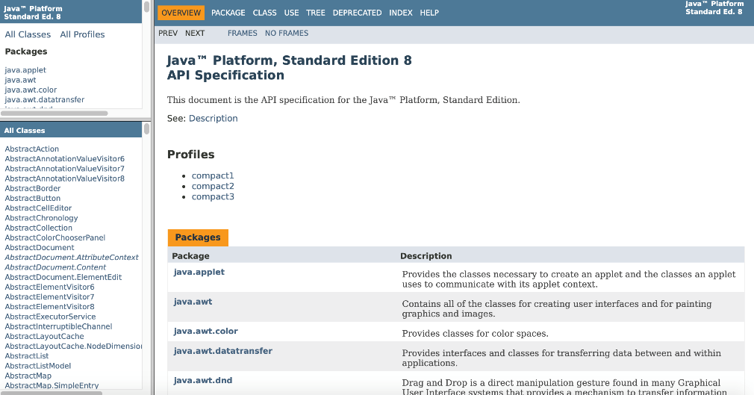
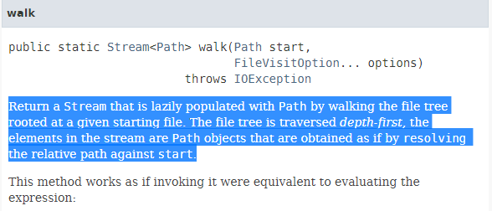
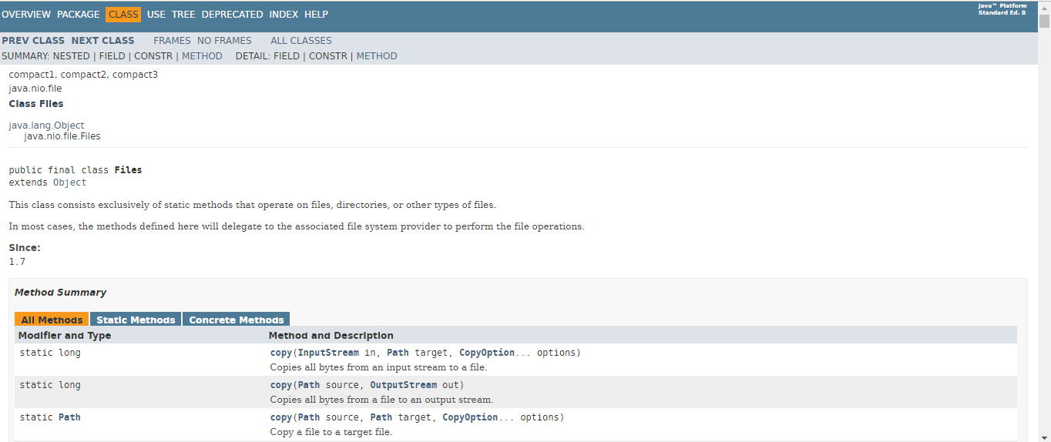
Scenario
How to add all files recursively from root with Java 8 Stream?
class description
JDK Reference Documentation
method description
java.nio.file.Files
4,602 Classes
129,214 Sentences
98 Methods
1,003 Sentences
method description
Notes:
Developers often need to find APIs relevant to their programming task. For example, There is a developer who wants to find the APIs that can add all files recursively from root with Java 8 stream. For this purpose, he had to search on JDK reference documentation. Well the JDK reference documentation has more than 4 thousands classess and allmost 130 thousand sentences. There are several classes relevant to this class. For example, the Files class from package file. There are some class description and method descriptions in this class document revealing its relevance to this task . However, such information is buried in the long discussion with 1000 sentences. Reading such a long document is a very painful thing. A better summarization approach is needed.
there is a developer
开发者经常需要找到
In this situation, develepers had to
Search on
API reference documentation contains knowledge for solving specific task.
For example, XXX.
Finding suching information not easy. We need a way to summary the class and help user to find the knowledge faster and accurate.
Java.nio.file.Files.walk(start, options...) Scenario
加入某个API检索的方法返回了一系列相关的API类，但是离完成这个任务实际上还是有区别。
Add all files recursively from root with Java 8 Stream
需求： 1. 判断这个类是否和问题相关
2. 判断这个类里面的哪些方法和我的问题有关
1. 什么场景需要summary
2. Google的搜索的结果，有什么不好I
3. 如果按照我们的思路会怎么解决
（API文档其实包含了对应的信息，我们的技术重点，API我文档中有这些信息，很多相关的概念，概念可以融合，不同概念之间有背景概念对于理解问题是重要的，API文档的知识类型不一样。）

Slide 4
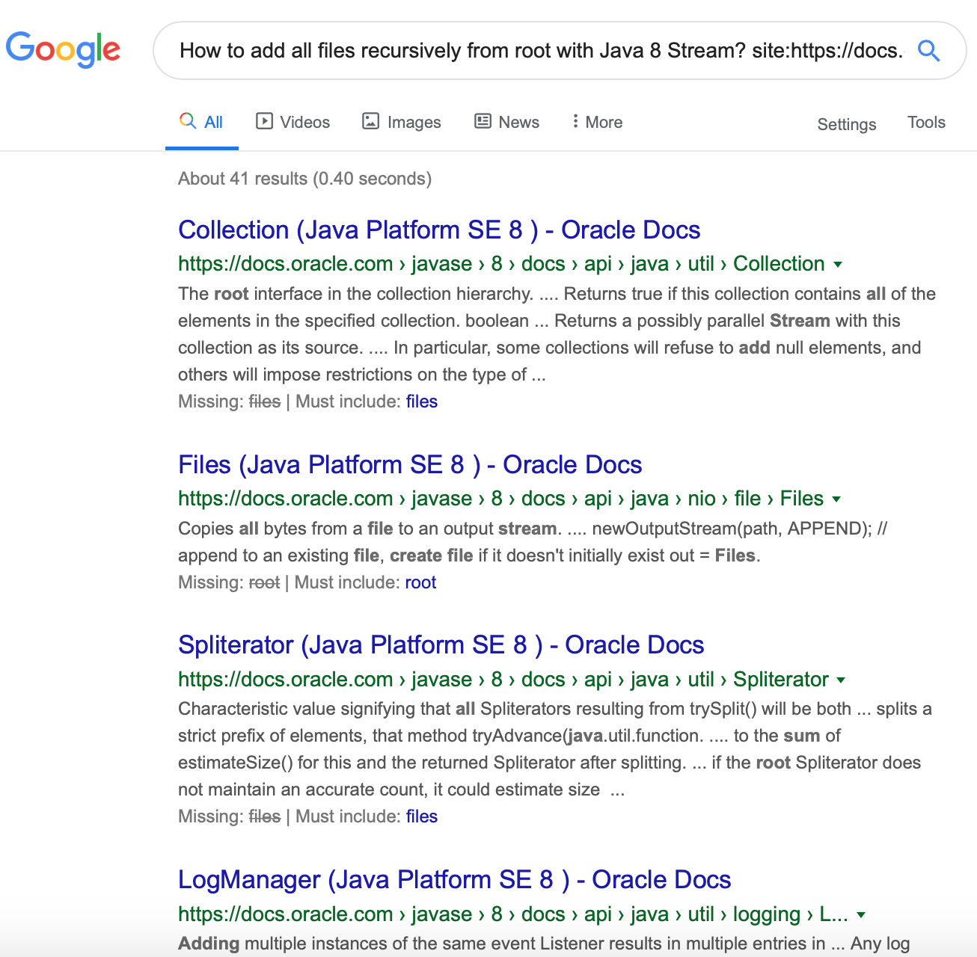
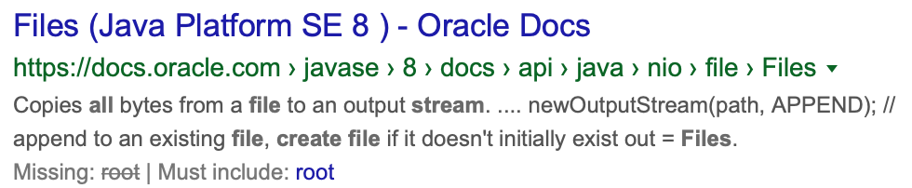
Search with Google
Matching by Keywords
Relevant descriptions are missing
Not designed for summarization!
Notes:
A normal way is to search the task with google on reference documentation, the google will return list of classes with some summaries. For example, the right side is showing the google summary for this the Files class. As you can see, it bold some keywords that match the query. In fact, this summary does not show why this class is related to the task. Developers still have to read the documents with one thousand sentences to find the relevant descriptions themselves. This is understandable, GOOGLE search is not designed for summary.
例如右边就展示google对于Files这个类的摘要。他用加粗的方式高亮了和query匹配的关键字。实际上，这个摘要根本没有展示这个类为何和这个任务相关。
开发者还是得阅读超过一千个句字来自己发现相关的描述，这个可以理解的，Google不是不是为了摘要设计的。
我们能够有一定的方式找到一些潜在的相关的API。 For example， search with google in documentation， some API retrieval Approach.
The problem may be how to determine which API is relevant to our Tasks. Further, some tasks is about is need some specific method in this class.
Google显示了一系列JDK文档中相关的类，高亮了一些匹配的关键字，显示了一些摘要. But this is not enough, normally I still need to read its original documentation.
还是不得不去阅读对应的API的类的文档来判断这个类和Task的相关性和找到能够完成任务的API, 这个摘要包含的信息不够，让人疑惑，都是关键字匹配，常见情况下开发者还是得点击到对应得API文档才能做更加进准确得判断。
其他的API搜索方法也是相同的问题。

Slide 5
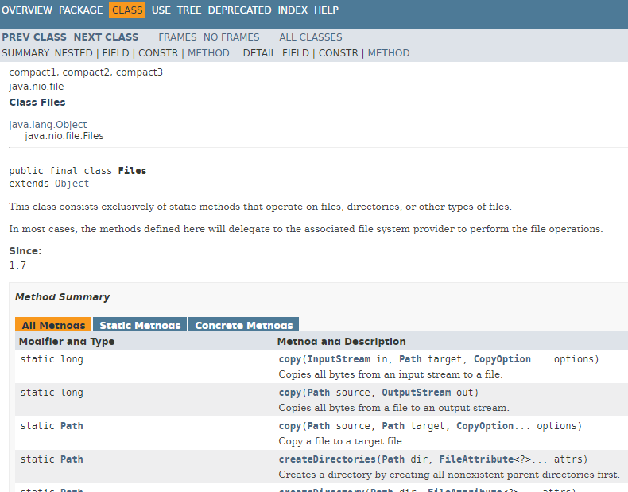
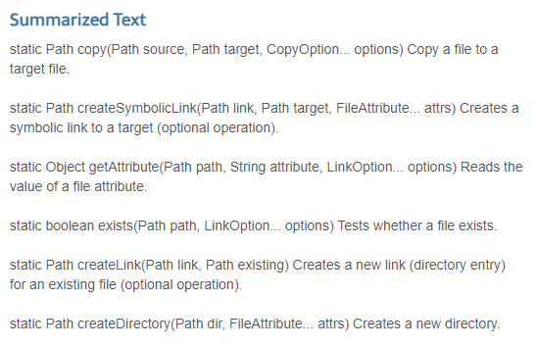
Use Text Summarization
Sentence selection by importance
Relevant descriptions are missing
Not query specific!
java.nio.file.Files
Notes:
What if we actually use some text summarization technic，
加入我们使用一些文本摘要技术能，比如textrank，我们可以对于这个类生成一个摘要。但是这个摘要中句子是根据他的文本的重要性选择出来的，相关的描述还是缺少的。这个揭示了一个问题，传统的摘要技术，无论用户的查询是什么，他的摘要永远是固定的，不是特定于查询的。
我们能够有一定的方式找到一些潜在的相关的API。 For example， search with google in documentation， some API retrieval Approach.
The problem may be how to determine which API is relevant to our Tasks. Further, some tasks is about is need some specific method in this class.
Google显示了一系列JDK文档中相关的类，高亮了一些匹配的关键字，显示了一些摘要. But this is not enough, normally I still need to read its original documentation.
还是不得不去阅读对应的API的类的文档来判断这个类和Task的相关性和找到能够完成任务的API, 这个摘要包含的信息不够，让人疑惑，都是关键字匹配，常见情况下开发者还是得点击到对应得API文档才能做更加进准确得判断。
其他的API搜索方法也是相同的问题。

Slide 6
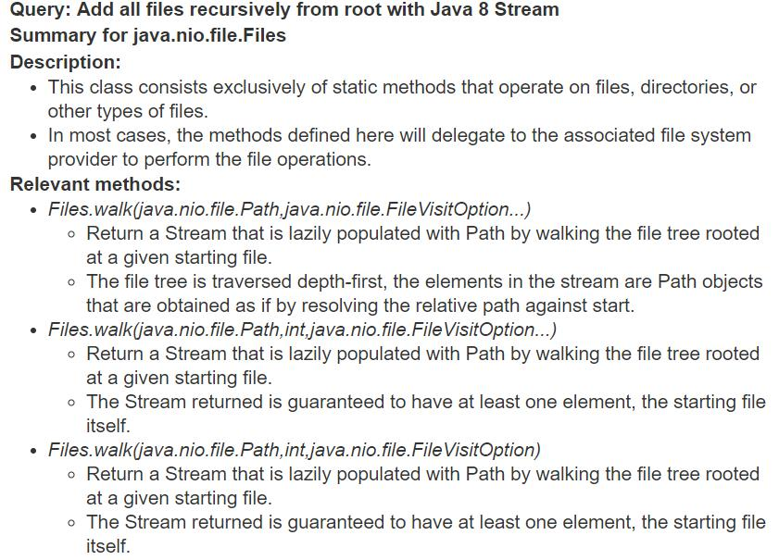
Query Specific API Summarization
Extractive Summaries for API classes
3 methods
8 sentences
Relevant
Class Description
Relevant
Methods
Relevant
Method Description
Notes:
所以我们提出了想法，要生成一个特定于查询的摘要，来更好地支持寻找和编程任务相关的API这个目的。幻灯片展示了我们想要生成的API类摘要例子，基于一个用自然语言查询表示的一个编程任务，这个摘要应该包含来自于类描述文本里面的相关的句子，还有相关的方法。每个相关的方法也包含一些相关的句子。
For supporting developers in finding APIs relevant to their programming task, we want to generate a hybrid summary for classes.
This slide shows how the class summary we want to generate looks like. Based on a given task, represented by natural language query. this summary should contain the most relevant sentences from class description, the most relevant methods in this class. It will contain the most relevant sentence from each relevant method.

Slide 7
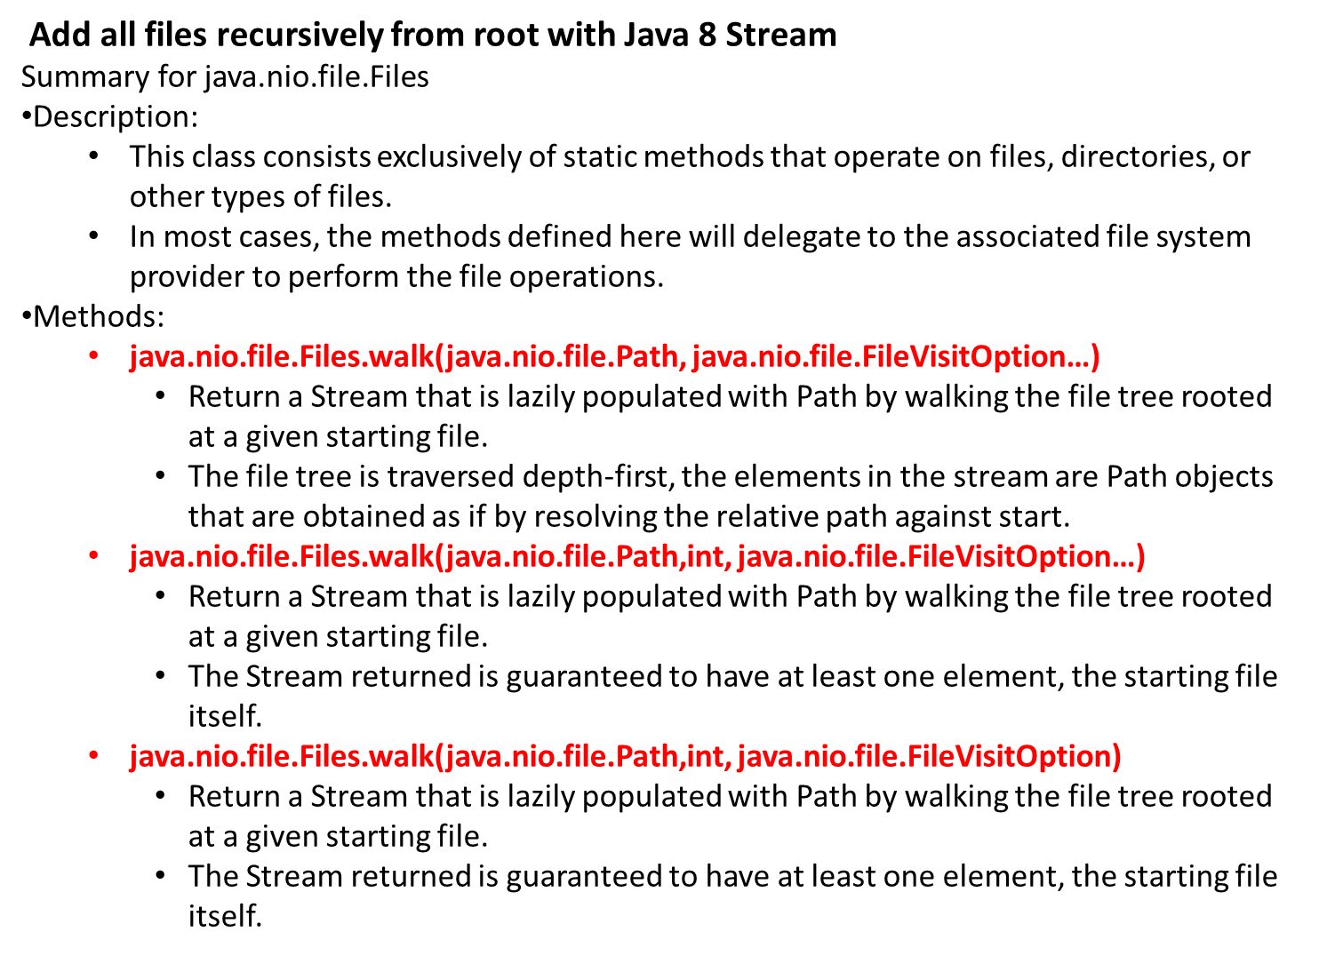
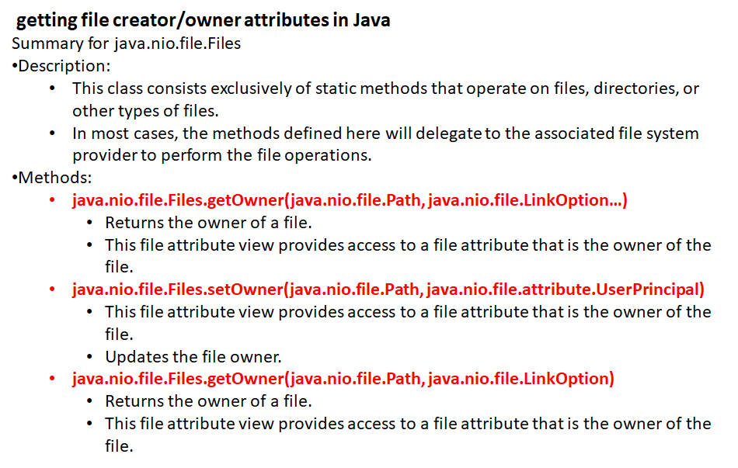
Query Specific API Summarization
Different Summaries of the Same Class for Different Queries
java.nio.file.Files
Notes:
Moreover, the summaries are query-specific. That is even for the same class, the summaries will be different because the task is different. The slide shows two different summaries of the same class for different task. The relevant method in the summaries are total different. This is natual because for diiferent tasks, the developers may want different information in this class.
我们的摘要的特点是特定于查询的，也就是，就算是对于同一个类，如果用户的编程任务不一样，我们的摘要也是不一样的。这个展示了对于两个不同的编程任务我们我们生成的摘要，可以看到在摘要中包含的相关的方法是完全不同的，这也很自然，因为对于不同的任务，开发者可能会希望来自于类的不同的信息。

Slide 8

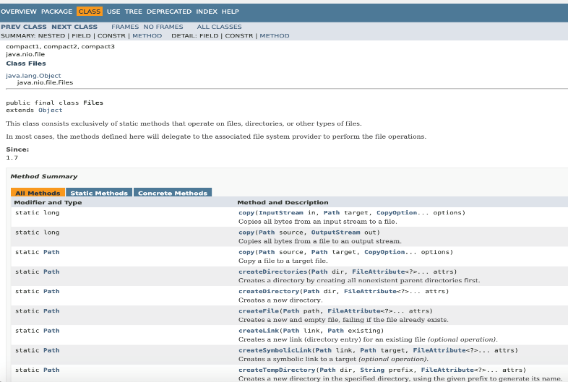
Knowledge Gap
How to make a symlink in Java when running in Linux ?
Some operating systems may require that the JVM be started with implementation specific privileges to create symbolic links
Notes:
For generating such query-specific summaries, selecting the sentences and methods relevant to the task is a challenge.
For example,
Text similarity between them is low, because they share no common words. It seem that the sentence is not relevant to the query at all.
However, if you look at the highlighted three important concepts in the query, they all have corresponding concepts in the descriptive sentences.
Linux is a operation systems.
JVM is used by Java.
Symlink is an alias of symbolic link.
In fact, this sentence is highly relevant to this task at concept level. Without the background knowledge such as Linux is a operation system, it is difficult to know the relevance. This is the knowledge gap. We need a way to bridge the Knowledge gap between query and the API reference documentation for generating the query-specific summaries.
为了解决这个问题，我们选择构建一个API知识图谱，然后在有了这个背景知识的支持下来做这种生成特定于查询的API摘要。
There is a Knowledge gap between the user query and the API reference documentation.
For generating such query-specific summaries selecting the sentences and methods relevant to the task is the challenge.
Because sometimes information relevant to programming task can not be found by simple information retrieval approach. There are some knowledge gap between the API reference documentation and the task.
For example, the method walk is relevant to the task because it return a stream object. This knowledge is from the code structure. And this is a sentence form method and it is relevant to the task. Text similarity between them is low. But they mentioned a lot of concepts that have interrelationships, such as files related to the file system, file trees, root directories and so on

Slide 9
/02
Approach
Notes:
Our approach could be divided into two phases, the first phase is the API KG Construction and it is offline. And the second phase the summary generation based on the API KG, which is an online sevice.

Slide 10
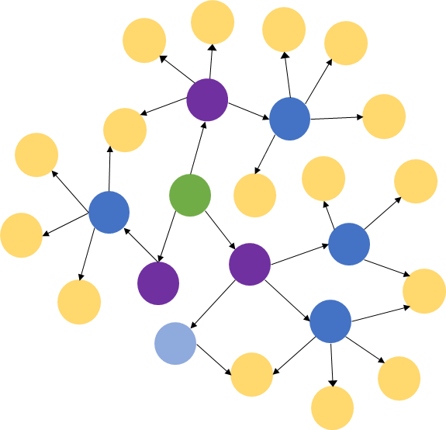

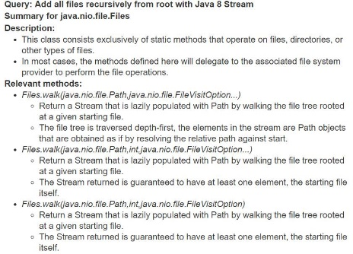

Basic Idea
API Knowledge Graph Construction
API Reference
Documentation
General Knowledge Graph
API Knowledge Graph
How to add all files recursively
from root with Java 8 Stream
Summary Generation
Notes:
Our approach can be divided into two phases, the first phase is the API knowledge graph , we extract knowledge from API reference documentation and Integrate background knowledge from general knowledge graph. This phase is offline. The second phase is the summary generation, we will accept the user query as input and generate the summaries for the classes relevant to the user query. This phase is offline.

Slide 11
API Knowledge Graph Construction Overview
General Concepts
Descriptive Knowledge Extraction
Text Descriptions
API Reference
Documentation
General Knowledge Graph
Descriptive
Knowledge
Generic Concept Filter
Structured Forms
Software Concepts
Structural
Knowledge
API Knowledge
Graph
Descriptive Knowledge
Structural Knowledge Extraction
Knowledge Fusion
Concepts and Relations
Notes:
First, we will extract structural knowledge by analyzing the structured forms in documentation. The structural knowledge includes the API elements for example, package, class, and the definition relations between them. The structural knowledge is the skeleton of our API =Knowledge graph.
We will link the descriptive knowledge to the API elements. When generating the summary, we will extract the relevant method descriptive knowledge from the API knowledge. In order to bridge the knowledge gap, we will fuse the knowledge in general into our API knowledge graph as the background knowledge . For example, Linux is a operation system could be found in general knowledge graph.
structural package and class, methods, parameters and
1、Generic Concept Filtering: We extract the software concepts from general knowledge graphs, such as Wikidata.
2、API Concept Reference Extraction: We identify parts of descriptive sentences of API elements that correspond to API concepts.
3、Cross Sentence Concept Fusion: We link different descriptive sentences of API elements that refer to the same API concept. The identified API concepts are added to the API KG with links from the descriptive sentences that reference the concepts.
4、Software Concept Fusion.We link API concepts or API entities to generic software-related concepts from the general KG (a.k.a. software concepts)
5、具体讲解例子

Slide 12
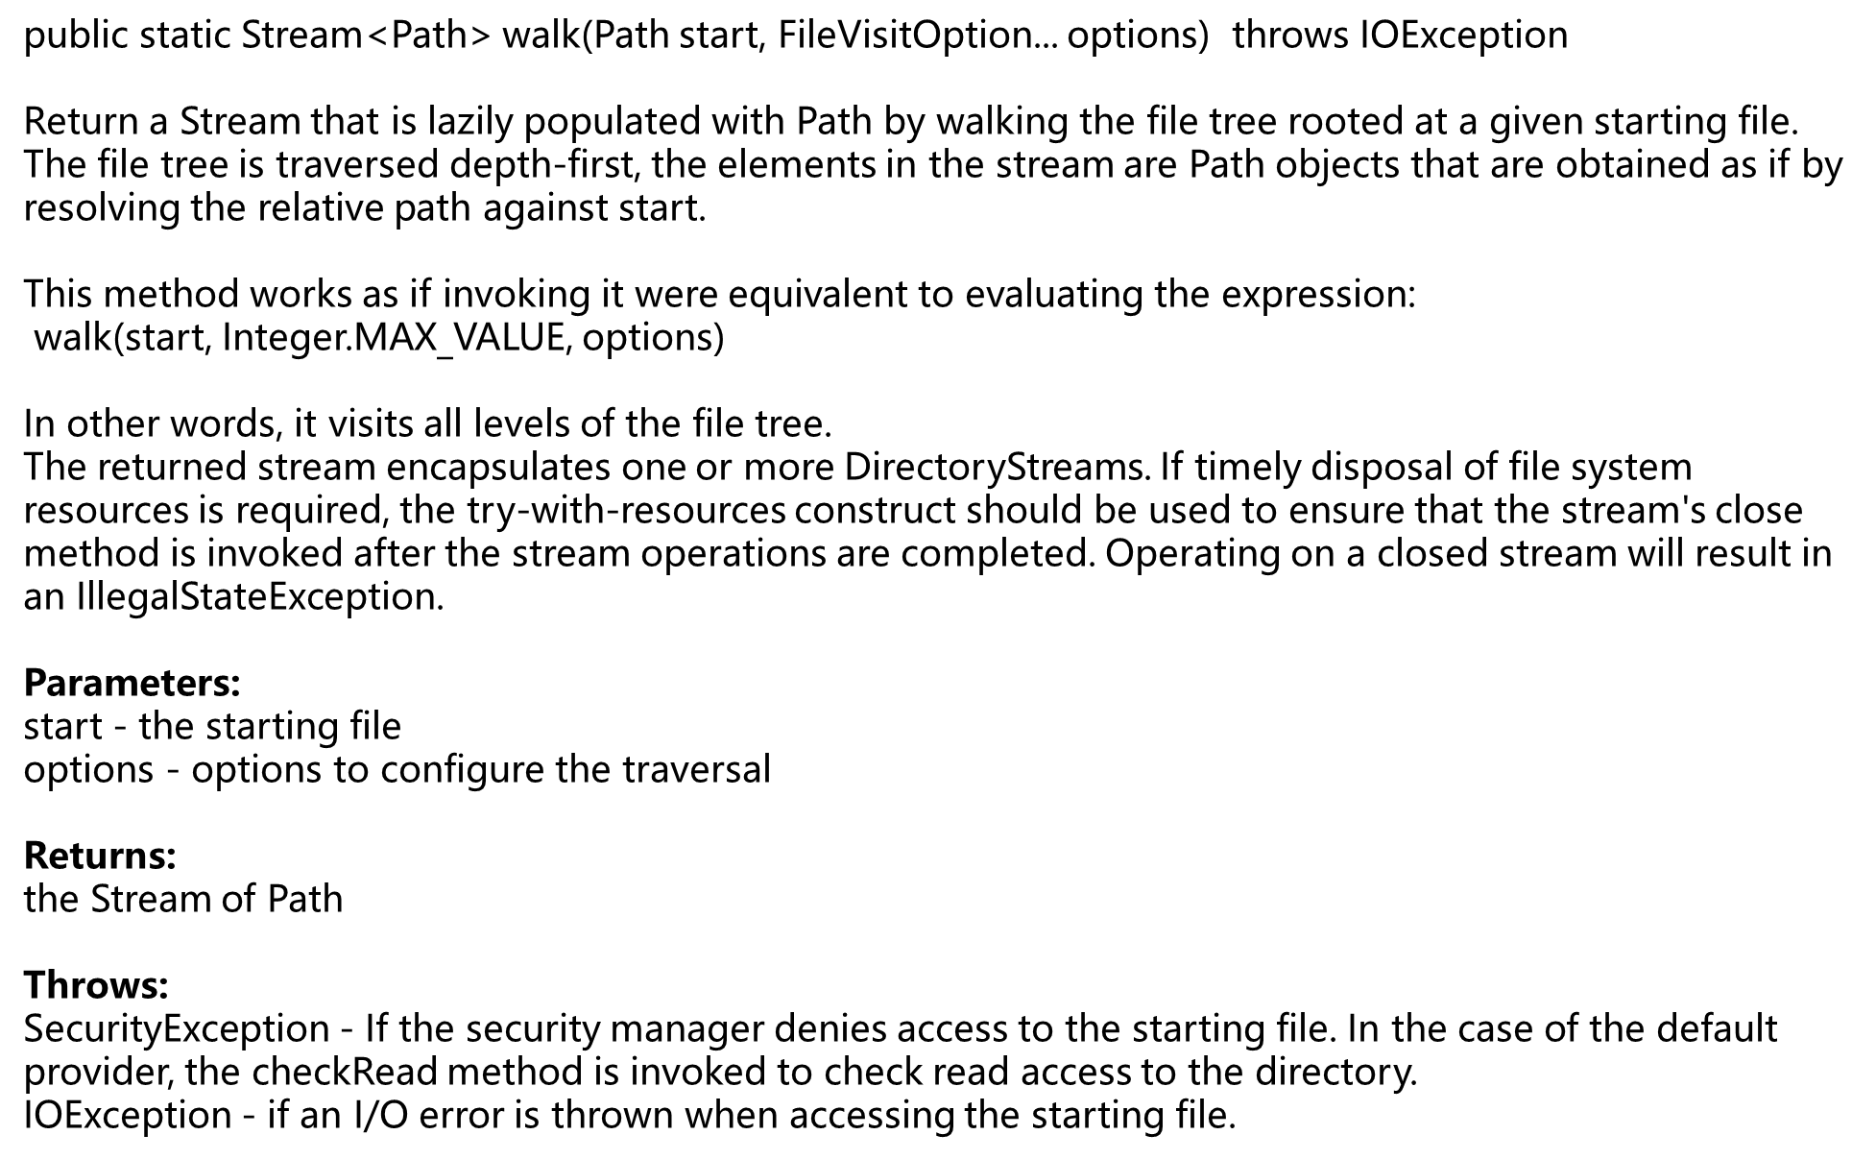
Structural Knowledge Extraction
java.nio.file.Files
API Reference Documentation
Notes:
In our paper, we use Api knowledge graph to narrow the gap of multiple information sources. The steps of API KG Construction are shown above.
1、Structural Knowledge Extraction：extract the structure of the API entities (e.g., API packages, classes, methods/fields) and the signatures of the APIs(e.g., parameters and return values of API methods). And we also extract the relationships between these API entities.

Slide 13
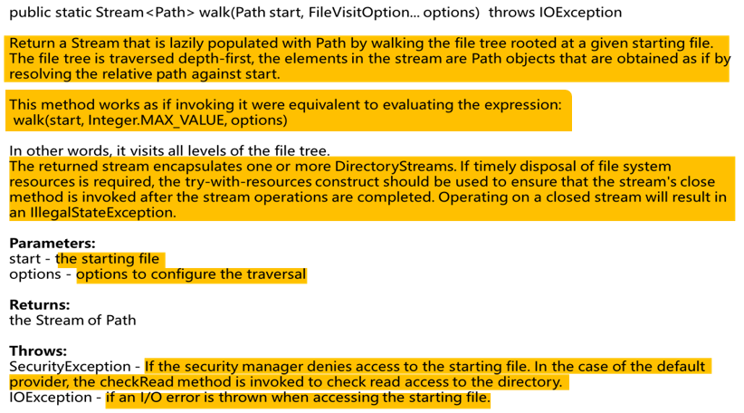
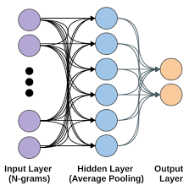
Descriptive Knowledge Extraction
API Reference
Documentation
Text Descriptions
Descriptive Sentence
Functionality + Directive
Descriptive Sentence
Classification
Notes:
We extract sentence from text descrption in documentation. We use a back propagation (BP) neural network [21] to train a classifier for classifying the sentences into one of the three types. Functionality, directive and others. The functionality describes what a API can do or can’t not. The directive describes the usage of the API such as, correct or
incorrect usage situations, constraints on method parameters. The type [other] is for all
other situations.
We only keep the sentences that are classified into Functionality and directive. We will add the functionality and directive sentence into knowledge graph and link them to the API element they extracted from.

Slide 14
Generic Concept Filter
Generic Concept
Software Concept
banana
basketball
football
file system
Generic Concept Classification
file system
stream
stream
directory
directory
Notes:
This step is to filter the generic concepts and only keep the concepts related to software and add trhem to the API knowledge . This generic concet filter done by a BP neral network classifier as well. For example,
The We want to enrich our knowledge graph with general kjnowledeg from general knowledge graph. For example, wikidata. Actually there are many in generic concepts in knowledge graph. Not all of them are we care about. We train a BP NURAL NETWORK TO CLASSIFIFY THE CONCEPT INTO TWO TYPE, SOFTWARE CONCEPT OR irrelevant concept. We only add the software concepts with their neibour concepts and relations into our API knowledge graph as the background knowledge.

Slide 15
Knowledge Fusion
Software Concept
method
directory
computer file
stream
path
file system
relatedTo
relatedTo
relatedTo
relatedTo
relatedTo
relatedTo
API Concept
static method
directory
file
stream
path
file tree
referTo
referTo
referTo
referTo
referTo
referTo
referTo
This class consists exclusively of static methods that operate on files, directories, or other types of files.
Return a Stream that is lazily populated with Path by walking the file tree rooted at a given starting file.
API Concept Reference
hasFunctionality
hasFunctionality
java.nio.file.Files
java.nio.file.Files.walk(Path,FileVisitOption...)
Notes:
1. We identify parts of descriptive sentences of API elements that correspond to API concepts. Concept references are extracted from descriptive sentences of
API elements by identifying noun phrases.
2、Cross Sentence Concept Fusion: We link different descriptive sentences of API elements that refer to the same API concept. To do this, we cluster the candidate concept references based on their lexical similarity and context similarity.
4、Software Concept Fusion. We link API concepts or API entities to generic software-related concepts from the general KG (a.k.a. software concepts). For each API concept, we collect all the descriptive sentences that include references to it. For each software concept, we use its text description
from the general knowledge graph (i.e., the corresponding Wikipedia article). We generate a vector for the concept by averaging
the vectors of words from its description. This software concept fusion is based on the context similarity between the software conpcets. In this way, descriptive knowledge are S

Slide 16
Resulting API Knowledge Graph
Descriptive Knowledge
API Concepts
API Reference
Documentation
Structural Knowledge
Software Concepts
Question: How to extract relevant information from API KG for summary generation
Notes:
1、Generic Concept Filtering: We extract the software concepts from general knowledge graphs, such as Wikidata.
2、API Concept Reference Extraction: We identify parts of descriptive sentences of API elements that correspond to API concepts.
3、Cross Sentence Concept Fusion: We link different descriptive sentences of API elements that refer to the same API concept. The identified API concepts are added to the API KG with links from the descriptive sentences that reference the concepts.
4、Software Concept Fusion.We link API concepts or API entities to generic software-related concepts from the general KG (a.k.a. software concepts)
5、具体讲解例子

Slide 17

Summary Generation
Similarity Calculation
Add all files recursively from root with java 8 Stream
…stream…
$$KGSim\left(q,e\right)=w_{1}∗{Sim}_{text}\left(q,e\right)+w_{2}∗{Sim}_{concept}(q,e)$$
…Files.walk…
Text Vector Space
add
file
root
…stream…
Java
Stream
Most Relevant Methods
Most Relevant Sentences
…files.walk…
Concept Vector Space
Notes:
For better compute the similarity between the entities in knowledge graph and the query, first We could represent each entity with two different vector from two different vector spaces, first we could get the description text for one entity and convert it in the text into a vector by averaging the vector of word in the description text. The vector for words is from a pretrained word2vec model trained on API reference documentation. If two entities with the similar description text, their text vector will be similar.
The we could use the node2vec to get the concept vector representation for each entities, which consider the graph structure into the representation. If two entities are close in knowledge graph(with many concepts as bridge), their concept vector is simiar.
We convert the query into the same vector space, to compute the similiary between the query and and the descriptive sentence or methods in concept level and text level.
1、Given a query, first step is to extract key words from query.
2、Then, get a set of candidate entities based on whether their names (including aliases), contain the keyword.
3、Next, through KG-based similarity（简单介绍一下相似度计算）, we get the most related entities.
4、Finally, we use structure of API KG to generate comments.

Slide 18
/03
Evaluation

Slide 19




Evaluation
Quality
Comparison
Usefulness
Variability
Notes:
We conducted several empirical studies to evaluate the intrinsic
quality and usefulness of the API summaries. Each picture represents a Research Questions.
RQ1 What is the intrinsic quality of the summaries generated by our approach?
RQ2
We are interested in
answering the following research questions about the summaries
generated by KG-APISumm .
RQ1 What is the intrinsic quality of the summaries
generated by KG-APISumm ?
RQ2 Howare the summaries generated by KG-APISumm different than those generated by other approaches?
RQ3 How useful are the summaries generated by KGAPISumm
in helping developers during API retrieval?
RQ4 Is KG-APISumm generating different summaries
for different queries, for the same class?

Slide 20
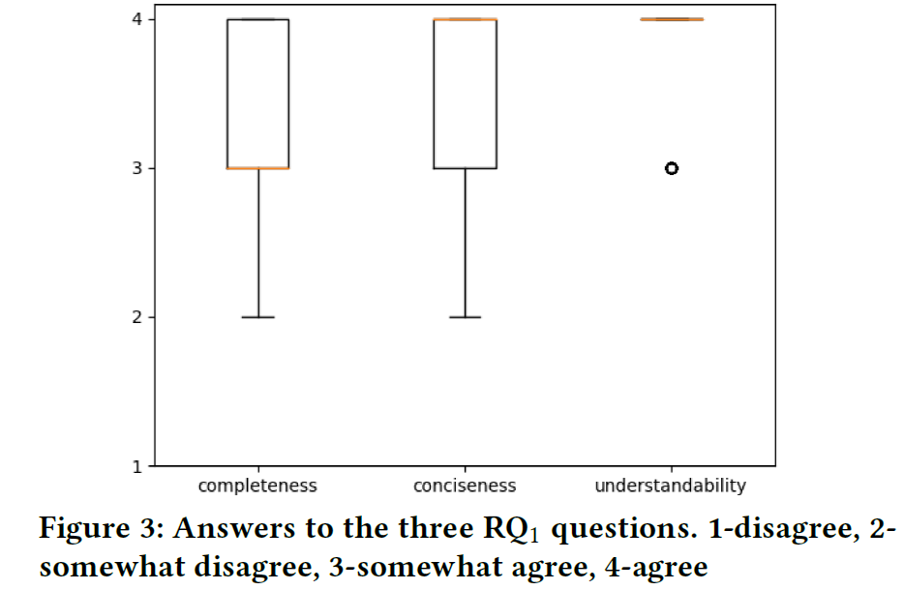
Evaluation for RQ1
4-points Likert scale on completeness, conciseness and understandability.
The summaries generated by our approach are complete, concise, and readable.
Notes:
1、We designed there criterions to evaluate the quality of our summary. (1)First criterion is Completeness–does the summary contain all the necessary
Information, (2)second is Conciseness–does the summary contain no (or very little) unnecessary or redundant information?, (3)third is Understandability–is the summary understandable?
2、For the 20 tasks, we ask participants to make point respectively on these three criterions.
3、Result shows the distribution of the answers for each question. For completeness 45.2% of the answers are 4 (agree), 45.2% are 3 (somewhat agree), 9.6% are 2 (somewhat disagree), and there are no 1 (disagree) answers. For conciseness 53.8% of the answers are 4, 36.6% are 3, 9.6% are 2, and there are no 1 answers. For understandability 80.6% of the answers are 4 , 19.4% are 3, and there are no 2 and 1 answers.

Slide 21
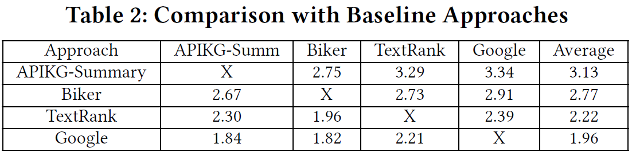
Evaluation for RQ2
4-points Likert scale on whether the unique information in summary is useful when comparing other summary
Information that appears only in our summaries is more relevant than information that appears only in the baseline summarises
Notes:
1、We compared our method with three based-line method（Biker, TextRank, Google Summary）. First, participants need to judge whether elements in two summary is unique then make point on each unique element.
2、Result shows the average ratings for each pair of methods. The average rating in cell indicates the rating of the information present in the summaries produced by the approach from row and not in those produced by the approach from column. Overall, our approach scored highest.

Slide 22
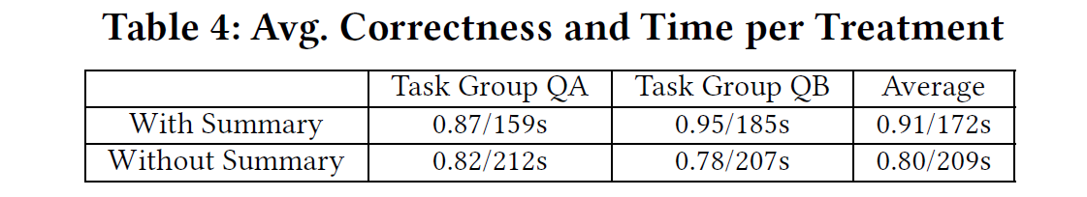
Evaluation for RQ3
Ask participants to complete API retrieval task with or without the help of our summary.
Our summaries help the users complete API retrieval task faster and more accurately.
Notes:
1、We perform an extrinsic evaluation for addressing RQ3. A group of students were asked to find the relevant classes to a query, returned by a tool named Biker. Students performed these tasks with and without having KG-APISumm generated summaries. The goal is to assess whether the use of the KG-APISumm summaries help in performing the given task.
2、结果说明。。。

Slide 23
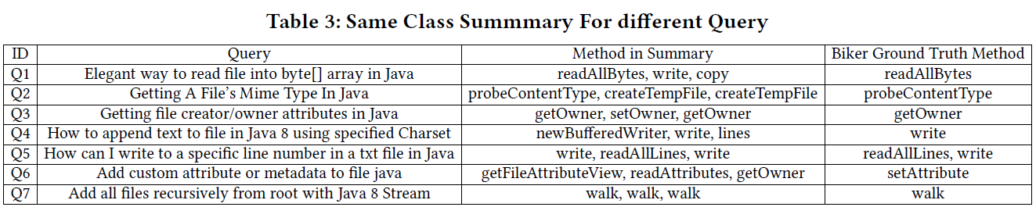
Evaluation for RQ4
User study for variability in the API Summaries
Our approach generates different summaries of the same class for different queries.
Notes:
As for RQ4, we provide examples of class that have distinct summaries for different queries. More detail information can be found on our website.

Slide 24
Conclusion
In this paper, we proposed a approach for automatically generating extractive, on-demand, query-specific summaries for classes based on API knowledge graph
Notes:
1. extractive, we extract most relevant methods and sentences for API
2. on-demand, we accept a user textual query, which describe the programming task at hand.
3. query-specific, we will generate Different Summaries of the Same Class for Different Queries.
4. Our summary is generated based

Slide 25
THANKS

Slide 26

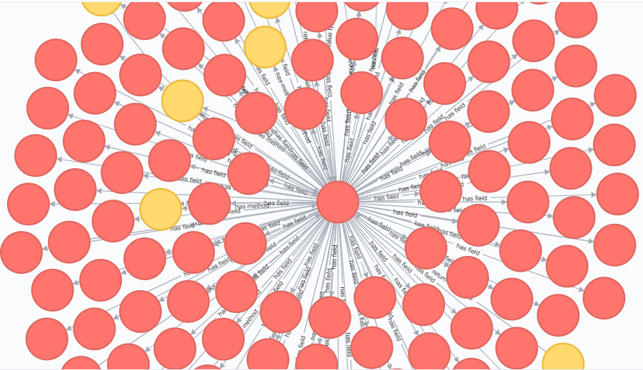
Methodology
Summary Generation
add
file
root
Java
Stream
…stream…
…file…
…add…
…file…
…java…
$$KGSim\left(q,e\right)=w_{1}∗{Sim}_{text}\left(q,e\right)+w_{2}∗{Sim}_{concept}(q,e)$$

Slide 27
Methodology
Summary Generation
add
file
root
Java
Stream
…stream…
…file…
…add…
…file…
…java…
$$KGSim\left(q,e\right)=w_{1}∗{Sim}_{text}\left(q,e\right)+w_{2}∗{Sim}_{concept}(q,e)$$

Slide 29

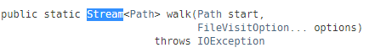
Challenge
stream
How to add all files recursively
from root with Java 8 Stream
API Reference Documentation
file system
Return a Stream that is lazily populated with Path by walking the file tree rooted at a given starting file
Code Structure
file path
file
file tree
root directory
directory
file tree walk
Knowledge Gap
Notes:
For generating such query-specific summaries selecting the sentences and methods relevant to the task is the challenge.
Because sometimes information relevant to programming task can not be found by simple information retrieval approach. There are some knowledge gap between the API reference documentation and the task.
For example, the method walk is relevant to the task because it return a stream object. This knowledge is from the code structure. And this is a sentence form method and it is relevant to the task. Text similarity between them is low. But they mentioned a lot of concepts that have interrelationships, such as files related to the file system, file trees, root directories and so on. In fact, this sentence is highly relevant to this task at concept level. Without the knowledge about the concepts as background knowledge, it is difficult to know the relevance.

